Slide 1

Lake Washington PCB/PBDE Study
Development and testing of a PCB fate model
Curtis DeGasperi and Greg Pelletier
King County Water and Land Resources Division
and Washington Department of Ecology
2014 Salish Sea Ecosystem Conference
May 1, 2014

Slide 2
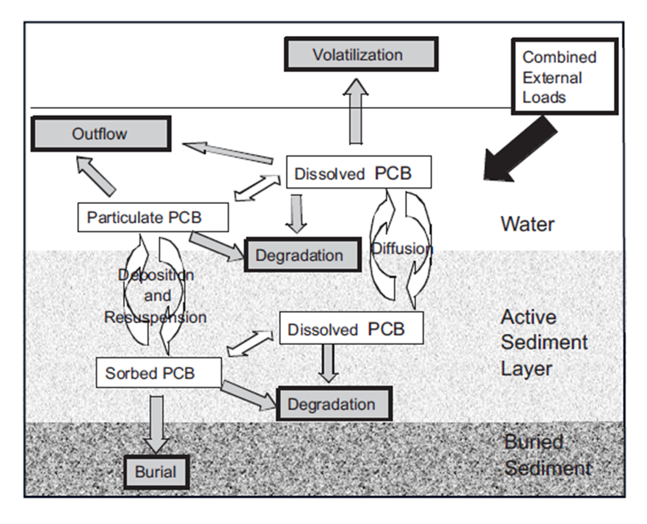
Fate Model Conceptual Diagram
Source: Davis (2004)

Slide 3
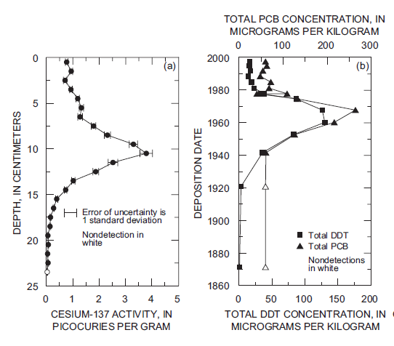
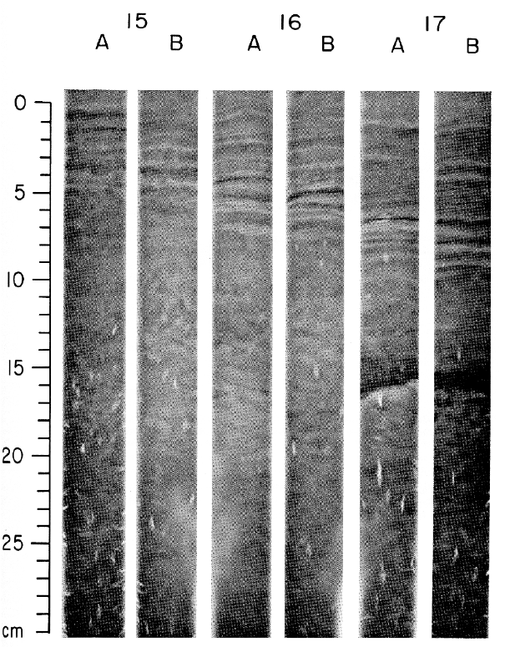
Active Sediment Layer
1964

Slide 4
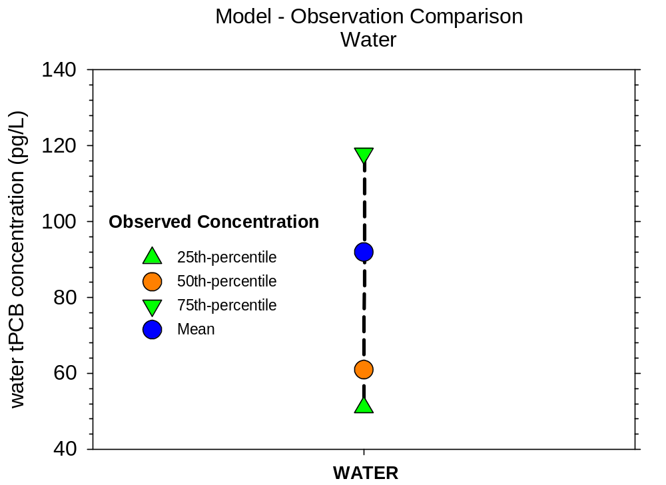
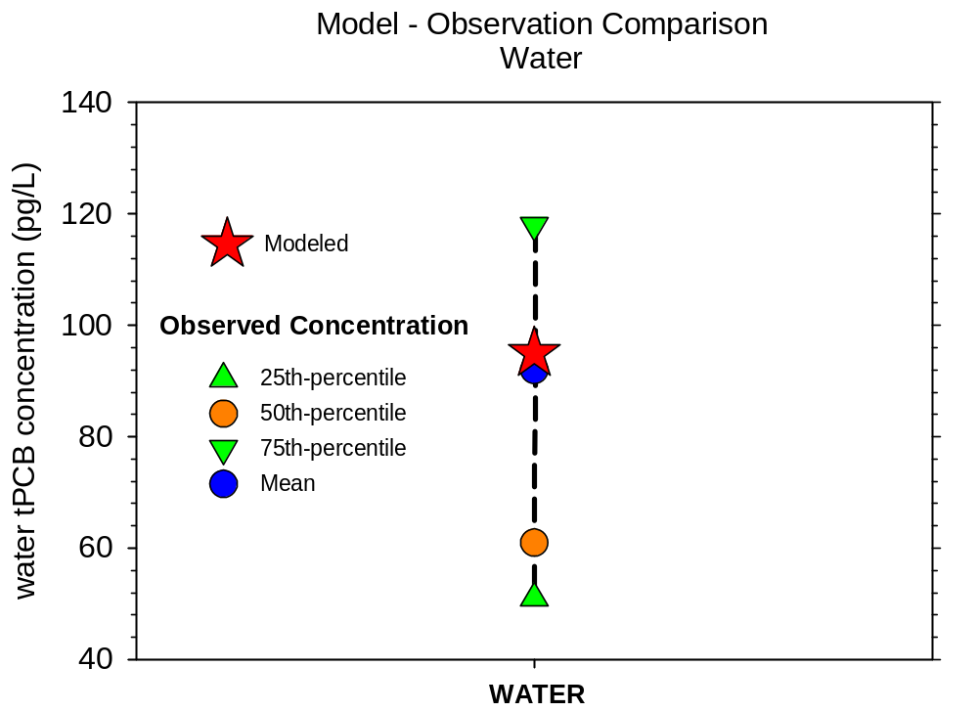
Fate Model
Hindcast
Hindcast Model Performance
(tPCB loading = 672 g/yr)
Concentration in Lake Water

Slide 5
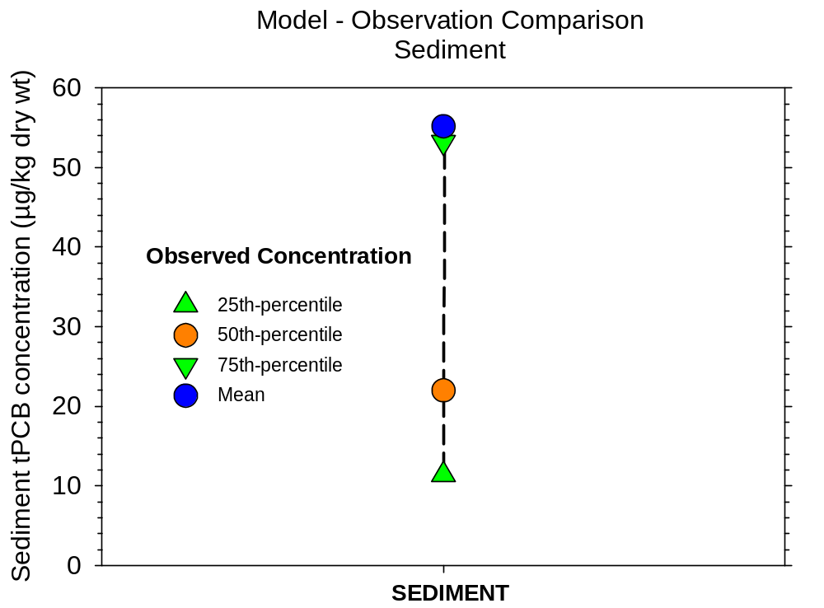
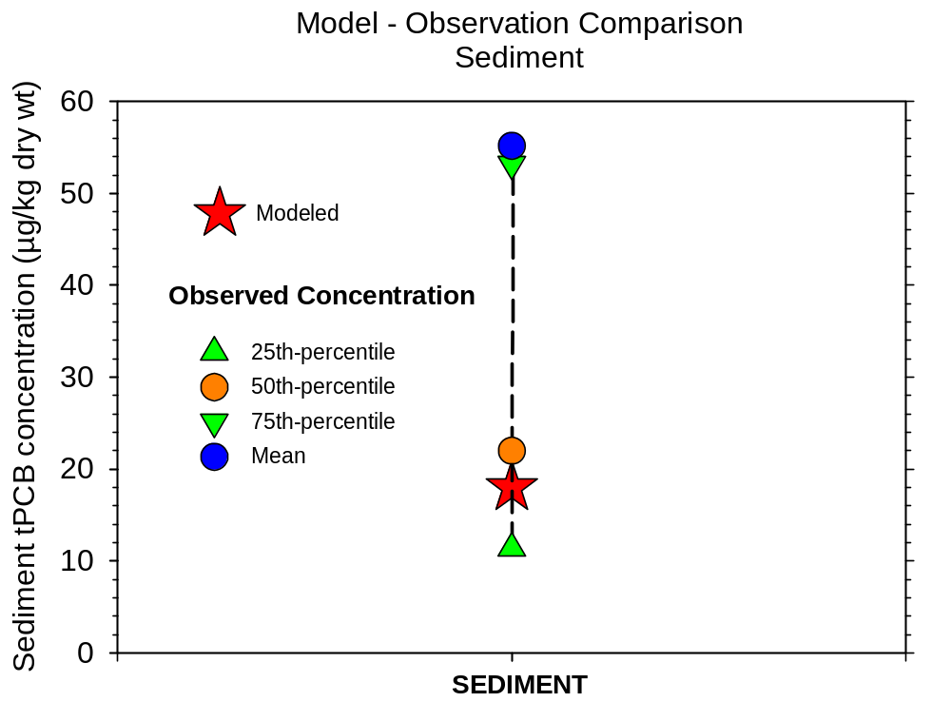
Fate Model
Hindcast
Hindcast Model Performance
(tPCB loading = 672 g/yr)
Concentration in Lake Sediment

Slide 6
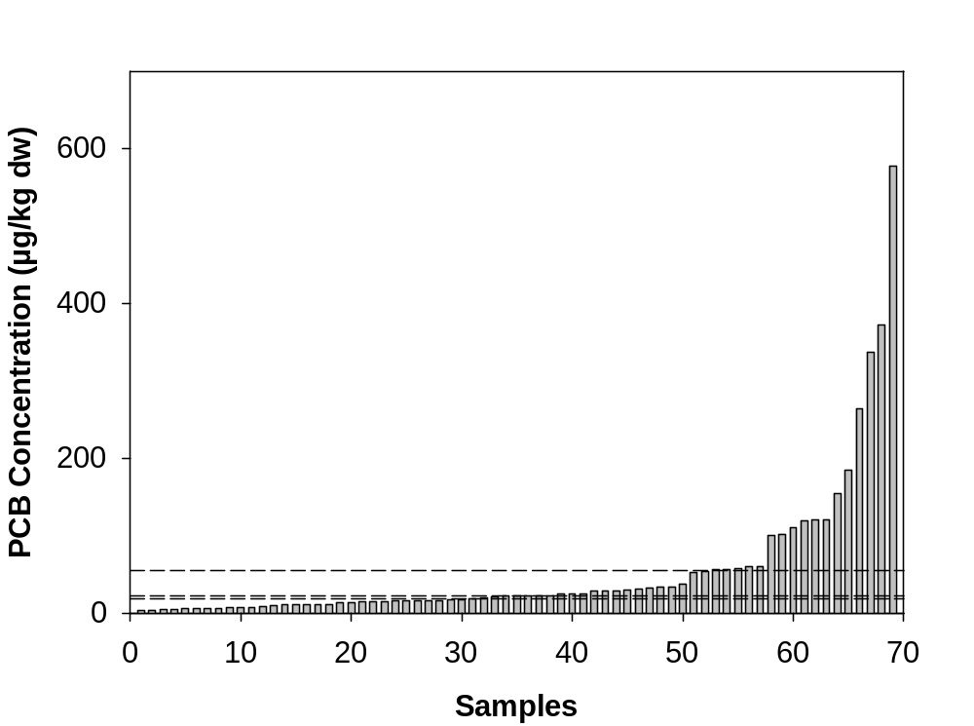
Fate Model
Hindcast
Hindcast Model Performance
(tPCB loading = 672 g/yr)
PCB Concentration in Lake Sediment
Mean strongly influenced
by these values
Model Predicted Conc.
= 18 µg/kg
Sample Mean
= 55 µg/kg
Sample Median
= 22 µg/kg

Slide 7
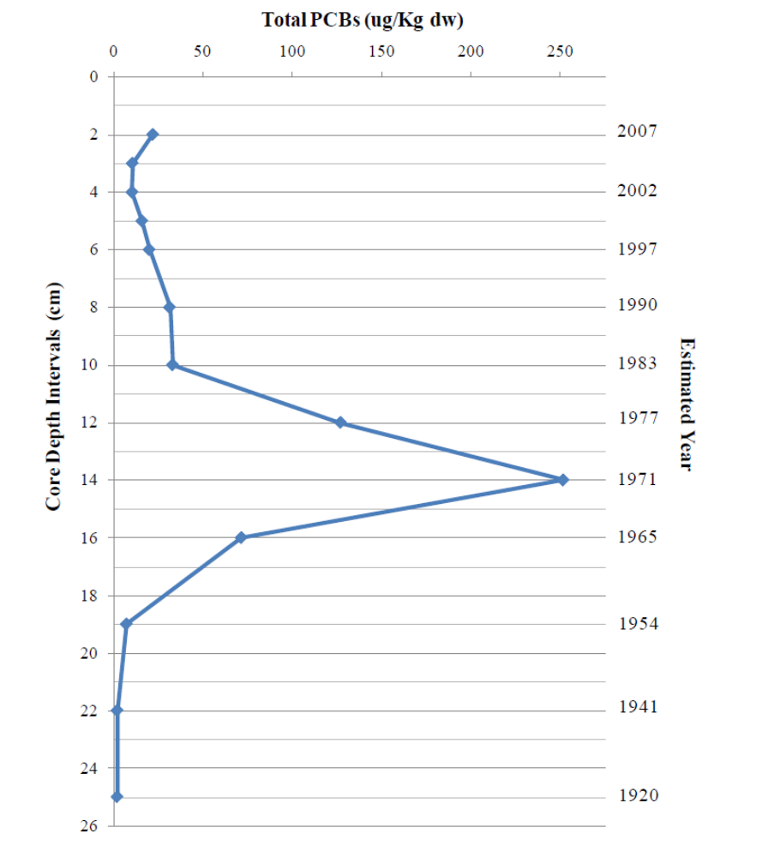
Historical Sediment Concentrations
Most 0-10 cm, some 0-2 cm sample depth
Mean = 55 ug/kg dry weight
2008 core shows rapid increase around10 cm
Production and use of PCBs restricted by EPA (1977)
Diversion of Secondary Wastewater Discharges
Commercial Production of PCBs begins in US (1929)

Slide 8
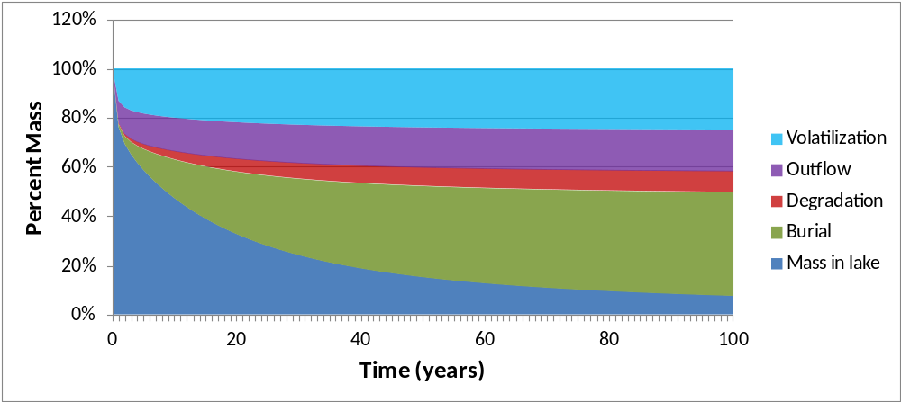
Fate Model
Hindcast
Hindcast Model Performance
(tPCB loading = 672 g/yr)
Fate Pathways

Slide 9
PCB Loading Summary
Bridges 3 g
CSOs 12 g
Rivers 97 g
Local Dr. 450 g
Volatilization
~185 g
110 g
4.8 g
?
140 g
360 g
Puget
Sound
672 g
Bridges 1 g
CSOs 58 g
Local Dr. 40 g
Lake Union/Ship Canal
Deep Burial
~350 g
Lake Washington
562 g + 110 g = 672 g
672 g – 140 g = 532 g

Slide 10
Fate Model Sensitivity Analysis
Sensitivity Analysis
  Overall, model most sensitive to octanol-water partition coefficient (Kow)
  Water column concentration/mass most sensitive to PCB loading rate
  Water column concentrations also sensitive to a number of other variables – e.g., concentration of solids in water and sediment

Slide 11
Fate Model Uncertainty Analysis
Uncertainty Analysis
  Low and high log₁₀(K_{ow}) – 6.01 and 6.86 (PCB-66 and PCB-153)
  Low and high tPCB loading rate – 0.333 and 0.889 kg yr⁻¹
  Model relatively more sensitive to tPCB loading uncertainty

Slide 12
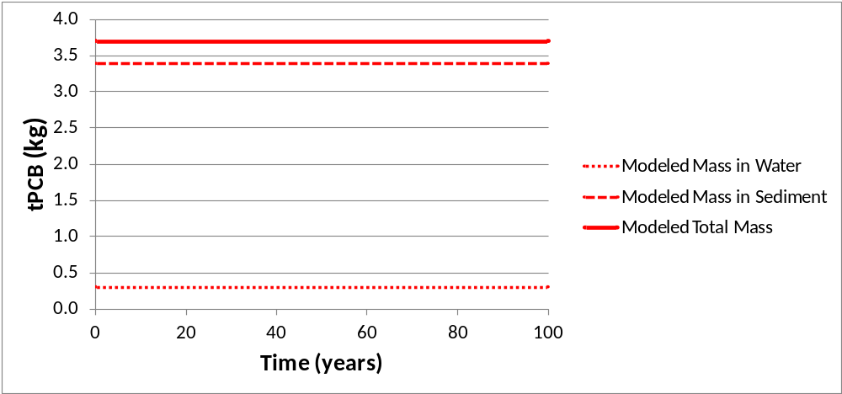
Fate Model
Forecast
Forecast Model Performance
(tPCB loading reduction
From 672 g/yr to ????)
tPCB mass in lake into future?
Total Mass
Sediment Mass
Total ?
Sediment ?
Forecast?
Water ?
Water Mass

Slide 13

QUESTIONS?
Search: lake washington pcb study
http://www.kingcounty.gov/environment/watersheds/cedar-river-lake-wa/pcb-pbde-loadings.aspx

